Slide 1
Analysis of Algorithms
Input
Algorithm
Output
An algorithm is a step-by-step procedure for
solving a problem in a finite amount of time.

Slide 2
Characteristics of a good algorithm
Precision – the steps are precisely stated(defined).
Uniqueness – results of each step are uniquely defined and only depend on the input and the result of the preceding steps.
Finiteness – the algorithm stops after a finite number of instructions are executed.
Input – the algorithm receives input.
Output – the algorithm produces output.
Generality – the algorithm applies to a set of inputs.

Slide 3
Running Time
Most algorithms transform input into output.
The running time of an algorithm typically grows with the input size.
Average case time is often difficult to determine.
We focus on the worst case running time.
Easier to analyze
Crucial to applications such as games, finance and robotics

Slide 4
Theoretical Analysis
Uses a high-level description of the algorithm instead of an implementation.
Characterizes running time as a function of the input size, n.
Takes into account all possible inputs
Allows us to evaluate the speed of an algorithm independent of the hardware/software environment.

Slide 5
Pseudocode
Example: find max element of an array.
High-level description of an algorithm.
More structured than English prose.
Less detailed than a program.
Preferred notation for describing algorithms
Hides program design issues.
Algorithm arrayMax(A, n)
Input array A of n integers
Output maximum element of A
currentMax ← A[0]
for i ← 1 to n − 1 do
if A[i] > currentMax then
currentMax ← A[i]
return currentMax

Slide 6
Pseudocode Details
Control flow
if … then … [else …]
while … do …
repeat … until …
for … do …
Indentation replaces braces
Method declaration
Algorithm method (arg [, arg…])
Input …
Output …
Method call
var.method (arg [, arg…])
Return value
return expression
Expressions
Assignment (like = in Java)
Equality testing (like == in Java)
n² Superscripts and other mathematical formatting allowed

Slide 7
Analyzing Algorithms
Has come to mean predicting the resources that the algorithm requires.
Usually computational time is resource of primary importance.
Aims to identify best choice among several alternate algorithms.
Requires an agreed-upon “model” of computation.
Shall use a generic, one-processor, random-access machine (RAM) model of computation.

Slide 8
The Random Access Memory (RAM) Model
A CPU.
An potentially unbounded bank of memory cells, each of which can hold an arbitrary number or character.
2
1
0
Memory cells are numbered and accessing any cell in memory takes unit time.

Slide 9
Random-Access Machine
Instructions are executed one after another (no concurrency).
Admits commonly found instructions in “real” computers, data movement operations, control mechanism.
Uses common data types (integer and float).
Other properties discussed as needed.
Care must be taken since model of computation has great implications on resulting analysis.

Slide 10
Primitive Operations
Basic computations performed by an algorithm
Identifiable in pseudocode
Largely independent from the programming language
Exact definition not important
Assumed to take a constant amount of time in the RAM model
Examples:
Evaluating an expression
Assigning a value to a variable
Indexing into an array
Calling a method
Returning from a method

Slide 11
Counting Primitive Operations
By inspecting the pseudocode, we can determine the maximum number of primitive operations executed by an algorithm, as a function of the input size
Algorithm arrayMax(A, n)
# operations
currentMax ← A[0]
for i ← 1 to n − 1 do
if A[i] > currentMax then currentMax ← A[i]
{ increment counter i }
return currentMax

Slide 12
Counting Primitive Operations
By inspecting the pseudocode, we can determine the maximum number of primitive operations executed by an algorithm, as a function of the input size
Algorithm arrayMax(A, n)
# operations
currentMax ← A[0] 2
for i ← 1 to n − 1 do
if A[i] > currentMax then currentMax ← A[i]
{ increment counter i }
return currentMax

Slide 13
Counting Primitive Operations
By inspecting the pseudocode, we can determine the maximum number of primitive operations executed by an algorithm, as a function of the input size
Algorithm arrayMax(A, n)
# operations
currentMax ← A[0] 2
for i ← 1 to n − 1 do n
if A[i] > currentMax then
currentMax ← A[i]
{ increment counter i }
return currentMax

Slide 14
Counting Primitive Operations
By inspecting the pseudocode, we can determine the maximum number of primitive operations executed by an algorithm, as a function of the input size
Algorithm arrayMax(A, n)
# operations
currentMax ← A[0] 2
for i ← 1 to n − 1 do n
if A[i] > currentMax then (n − 1)
currentMax ← A[i]
{ increment counter i }
return currentMax

Slide 15
Counting Primitive Operations
By inspecting the pseudocode, we can determine the maximum number of primitive operations executed by an algorithm, as a function of the input size
Algorithm arrayMax(A, n)
# operations
currentMax ← A[0] 2
for i ← 1 to n − 1 do n
if A[i] > currentMax then (n − 1)
currentMax ← A[i] (n − 1)
{ increment counter i }
return currentMax

Slide 16
Counting Primitive Operations
By inspecting the pseudocode, we can determine the maximum number of primitive operations executed by an algorithm, as a function of the input size
Algorithm arrayMax(A, n)
# operations
currentMax ← A[0] 2
for i ← 1 to n − 1 do n
if A[i] > currentMax then (n − 1)
currentMax ← A[i] (n − 1)
{ increment counter i } (n − 1)
return currentMax

Slide 17
Counting Primitive Operations
By inspecting the pseudocode, we can determine the maximum number of primitive operations executed by an algorithm, as a function of the input size
Algorithm arrayMax(A, n)
# operations
currentMax ← A[0] 2
for i ← 1 to n − 1 do n
if A[i] > currentMax then (n − 1)
currentMax ← A[i] (n − 1)
{ increment counter i } (n − 1)
return currentMax 1

Slide 18
Counting Primitive Operations
By inspecting the pseudocode, we can determine the maximum number of primitive operations executed by an algorithm, as a function of the input size
Algorithm arrayMax(A, n)
# operations
currentMax ← A[0] 2
for i ← 1 to n − 1 do n
if A[i] > currentMax then (n − 1)
currentMax ← A[i] (n − 1)
{ increment counter i } (n − 1)
return currentMax 1
Total 4n

Slide 19
Estimating Running Time
Algorithm arrayMax executes 4n primitive operations in the worst case.
Define:
a = Time taken by the fastest primitive operation
b = Time taken by the slowest primitive operation
Let T(n) be worst-case time of arrayMax. Then a (4n) ≤ T(n) ≤ b(4n)
Hence, the running time T(n) is bounded by two linear functions.

Slide 20
Order of Growth
Simplifying abstraction: interested in rate of growth or order of growth of the running time of the algorithm
Allows us to compare algorithms without worrying about implementation performance
Usually only highest order term without constant coefficient is taken
Uses “theta” notation
Best case of insertion sort is Θ(n)
Worst case of insertion sort is Θ(n²)

Slide 21
Growth Rate of Running Time
Changing the hardware/ software environment
Affects T(n) by a constant factor, but
Does not alter the growth rate of T(n)
The linear growth rate of the running time T(n) is an intrinsic property of algorithm arrayMax

Slide 22
Seven Important Functions
Seven functions that often appear in algorithm analysis:
Constant ≈ 1
Logarithmic ≈ log n
Linear ≈ n
N-Log-N ≈ n log n
Quadratic ≈ n²
Cubic ≈ n³
Exponential ≈ 2^{n}
In a log-log chart, the slope of the line corresponds to the growth rate of the function

Slide 23
Analysis of Algorithms
What is the goal?
Analyze time requirements - predict how running time increases as the size of the problem increases:
Why is it useful?
To compare different algorithms.
time = f(size)

Slide 24
Defining “problem size”
Typically, it is straightforward to identify the size of a problem, e.g.:
size of array
size of stack, queue, list etc.
vertices and edges in a graph

Slide 25
Time Analysis
Provides upper and lower bounds of running time.
Different types of analysis:
- Worst case
- Best case
- Average case

Slide 26
Worst Case
Provides an upper bound on running time.
An absolute guarantee that the algorithm would not run longer, no matter what the inputs are.

Slide 27
Best Case
Provides a lower bound on running time.
Input is the one for which the algorithm runs the fastest.

Slide 28
Average Case
Provides an estimate of “average” running time.
Assumes that the input is random.
Useful when best/worst cases do not happen very often (i.e., few input cases lead to best/worst cases).

Slide 29
Example: Searching
Problem of searching an ordered list.
Given a list L of n elements that are sorted into a definite order (e.g., numeric, alphabetical),
And given a particular element x,
Determine whether x appears in the list, and if so, return its index (i.e., position) in the list.

Slide 30
Linear Search
procedure linear search (x: integer, a₁, a₂, …, a_{n}: distinct integers) i := 1 while (i ≤ n ∧ x ≠ a_{i}) i := i + 1 if i ≤ n then location := i else location := 0 return location

Slide 31
How do we analyze an algorithm?
Need to define objective measures.
(1) Compare execution times?
Not good: times are specific to a particular machine.
(2) Count the number of statements?
Not good: number of statements varies with programming language and programming style.

Slide 32
Example
Algorithm 1 Algorithm 2
arr[0] = 0; for(i=0; i<N; i++)
arr[1] = 0; arr[i] = 0;
arr[2] = 0;
...
arr[N-1] = 0;

Slide 33
How do we analyze an algorithm? (cont.)
(3) Express running time t as a function of problem size n (i.e., t=f(n) ).
Given two algorithms having running times f(n) and g(n), find which functions grows faster.
- Such an analysis is independent of machine time, programming style, etc.

Slide 34
How do we find f(n)?
(1) Associate a "cost" with each statement.
(2) Find total number of times each statement is executed.
(3) Add up the costs.
Algorithm 1 Algorithm 2
Cost Cost
arr[0] = 0; c₁ for(i=0; i<N; i++) c₂
arr[1] = 0; c₁ arr[i] = 0; c₁
arr[2] = 0; c₁
...
arr[N-1] = 0; c₁
----------- -------------
c₁+c₁+...+c₁ = c₁ x N (N+1) x c₂ + N x c₁ =
(c₂ + c₁) x N + c₂

Slide 35
How do we find f(n)? (cont.)
Cost Times
sum = 0; c₁ 1
for(i=0; i<N; i++) c_{2 N+1}
for(j=0; j<N; j++) c₂ N*(N+1)
sum += arr[i][j]; c_{3 N*N}
------------
c₁ + c₂ x (N+1) + c₂ x N x (N+1) + c₃ x N x N

Slide 36
Comparing algorithms
Given two algorithms having running times f(n) and g(n), how do we decide which one is faster?
Compare “rates of growth” of f(n) and g(n)

Slide 37
Understanding Rate of Growth
Consider the example of buying elephants and fish:
Cost: (cost_of_elephants) + (cost_of_fish)
Approximation:
Cost ~ cost_of_elephants

Slide 38
Understanding Rate of Growth (cont’d)
The low order terms of a function are relatively insignificant for large n
n⁴ + 100n² + 10n + 50
Approximation:
n⁴
Highest order term determines rate of growth!

Slide 39
Example
Suppose you are designing a website to process user data (e.g., financial records).
Suppose program A takes f_{A}(n)=30n+8 microseconds to process any n records, while program B takes f_{B}(n)=n²+1 microseconds to process the n records.
Which program would you choose, knowing you’ll want to support millions of users?

Slide 40
Example
Suppose you are designing a website to process user data (e.g., financial records).
Suppose program A takes f_{A}(n)=30n+8 microseconds to process any n records, while program B takes f_{B}(n)=n²+1 microseconds to process the n records.
Which program would you choose, knowing you’ll want to support millions of users?
A
Compare rates of growth:
30n+8 ~ n and n²+1 ~ n²

Slide 41
Rate of Growth ≡Asymptotic Analysis
Using rate of growth as a measure to compare different functions implies comparing them asymptotically (i.e., as n → )
If f(x) is faster growing than g(x), then f(x) always eventually becomes larger than g(x) in the limit (i.e., for large enough values of x).

Slide 42
Growth Function
Order of growth of functions provides a simple characterization of efficiency
Allows for comparison of relative performance between alternative algorithms
Concerned with asymptotic efficiency of algorithms
Best asymptotic efficiency usually is best choice except for smaller inputs
Several standard methods to simplify asymptotic analysis of algorithms

Slide 43
Asymptotic Notation
Applies to functions whose domains are the set of natural numbers: N = {0,1,2,…}
If time resource T(n) is being analyzed, the function’s range is usually the set of non-negative real numbers: T(n) ∈ R⁺
If space resource S(n) is being analyzed, the function’s range is usually also the set of natural numbers: S(n) ∈ N

Slide 44
Asymptotic Notation
O notation: asymptotic “less than”:
f(n)=O(g(n)) implies: f(n) “≤” g(n)
Ω notation: asymptotic “greater than”:
f(n)= Ω (g(n)) implies: f(n) “≥” g(n)
Θ notation: asymptotic “equality”:
f(n)= Θ (g(n)) implies: f(n) “=” g(n)

Slide 45
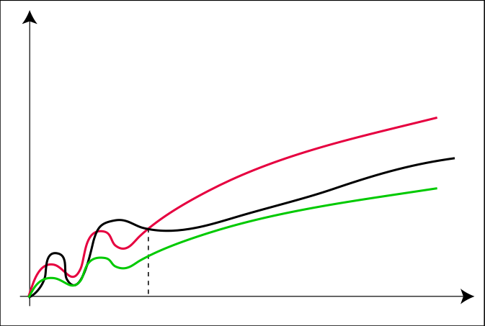
The Θ-Notation
Θ(g(n)) = { f(n) : ∃c₁, c₂ > 0, n₀ > 0 s.t. ∀n ≥ n₀: c₁ · g(n) ≤ f(n) ≤ c₂ ⋅ g(n) }
c₂ ⋅ g
f
c₁ ⋅ g
n₀

Slide 46
Asymptotic Θ Notation
Θ notation: asymptotic “equality”:
f(n)= Θ (g(n)) implies: f(n) “=” c g(n) in the limit*
c is a constant
(provides a tight bound of running time)
(best and worst cases are same)
*formal definition in CS477/677

Slide 47
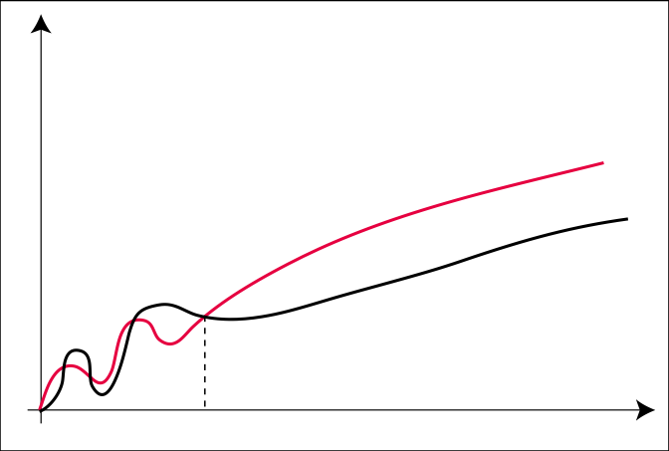
The O-Notation
O(g(n)) = { f(n) : ∃c > 0, n₀ > 0 s.t. ∀n ≥ n₀: f(n) ≤ c ⋅ g(n) }
c ⋅ g
f
n₀

Slide 48
Asymptotic O Notation
O notation: asymptotic “less than”:
f(n)=O(g(n)) implies: f(n) “≤” c g(n) in the limit*
c is a constant
(used in worst-case analysis)
*formal definition in CS477/677

Slide 49
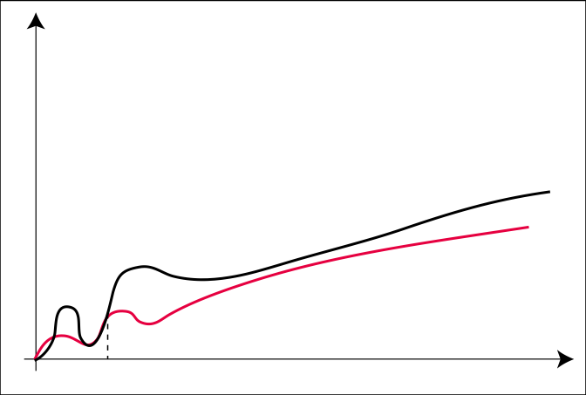
The Ω-Notation
Ω(g(n)) = { f(n) : ∃c > 0, n₀ > 0 s.t. ∀n ≥ n₀: f(n) ≥ c ⋅ g(n) }
f
c ⋅ g
n₀

Slide 50
Asymptotic Notation
Ω notation: asymptotic “greater than”:
f(n)= Ω (g(n)) implies: f(n) “≥” c g(n) in the limit*
c is a constant
(used in best-case analysis)
*formal definition in CS477/677

Slide 51
Big-O Notation - Examples
f_{A}(n)=30n+8
f_{B}(n)=n²+1
10n³ + 2n²
n³ - n²
1273

Slide 52
Big-O Notation - Examples
f_{A}(n)=30n+8
f_{B}(n)=n²+1
10n³ + 2n²
n³ - n²
1273
is O(n)
is O(n²)
is O(n³)
is O(n³)
is O(1)

Slide 53
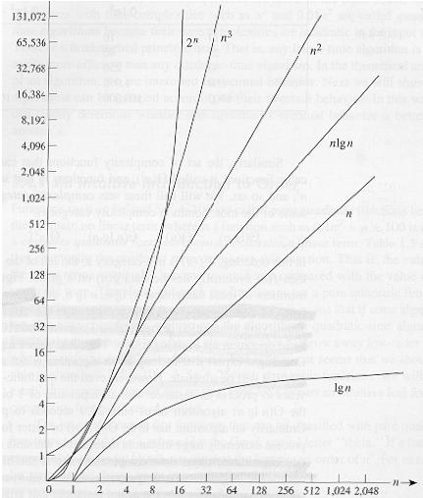
Common orders of magnitude

Slide 54
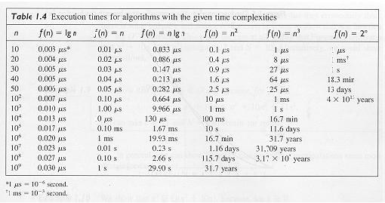

Slide 55
Estimating running time
Algorithm 1 Algorithm 2
Cost Cost
arr[0] = 0; c1 for(i=0; i<N; i++) c2
arr[1] = 0; c1 arr[i] = 0; c1
arr[2] = 0; c1
...
arr[N-1] = 0; c1
----------- -------------
c1+c1+...+c1 = c1 x N (N+1) x c2 + N x c1 =
(c2 + c1) x N + c2
O(N)

Slide 56
Estimate running time (cont.)
Cost
sum = 0; c1
for(i=0; i<N; i++) c2
for(j=0; j<N; j++) c2
sum += arr[i][j]; c3 ------------
c1 + c2 x (N+1) + c2 x N x (N+1) + c3 x N x N
O(N²)

Slide 57
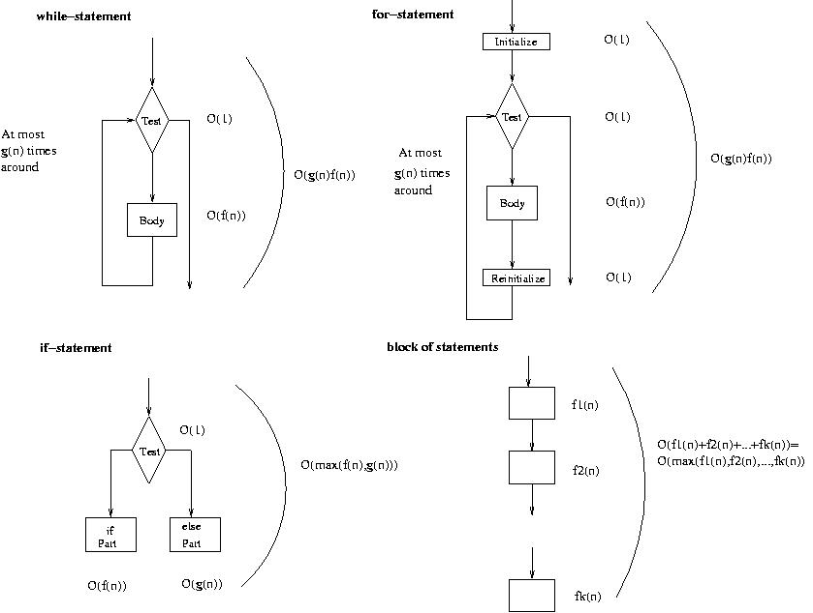
Running time of various statements
while-loop
for-loop

Slide 58
Examples
i = 0;
while (i<N) {
X=X+Y; // O(1)
result = mystery(X); // O(N), just an example...
i++; // O(1)
}
The body of the while loop: O(N)
Loop is executed: N times
N x O(N) = O(N²)

Slide 59
Examples (cont.’d)
if (i<j)
for ( i=0; i<N; i++ )
X = X+i;
else
X=0;
Max ( O(N), O(1) ) = O (N)
O(N)
O(1)

Slide 60
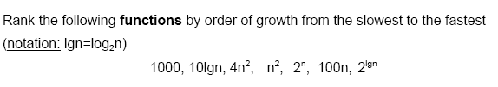
Examples (cont.’d)

Slide 61

Examples (cont.’d)

Slide 62

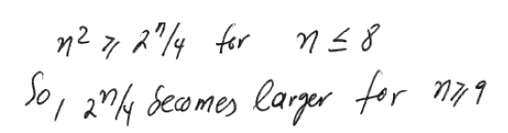
Examples (cont.’d)

Slide 63
Standard Notation and Common Functions
Monotonicity
A function f(n) is monotonically increasing if m ≤ n implies f(m) ≤ f(n) .
A function f(n) is monotonically decreasing if m ≤ n implies f(m) ≥ f(n) .
A function f(n) is strictly increasing if m < n implies f(m) < f(n) .
A function f(n) is strictly decreasing if m < n implies f(m) > f(n) .

Slide 64
Standard Notation and Common Functions
Exponentials
For all n and a≥1, the function a^{n} is the exponential function with base a and is monotonically increasing.
Logarithms
Textbook adopts the following convention lg n = log₂n (binary logarithm), ln n = log_{e}n (natural logarithm), lg^{k} n = (lg n)^{k} (exponentiation), lg lg n = lg(lg n) (composition), lg n + k = (lg n)+k (precedence of lg).
ai

Slide 65
Standard Notation and Common Functions
Important relationships
For all real constants a and b such that a>1, n^{b} = o(a^{n}) that is, any exponential function with a base strictly greater than unity grows faster than any polynomial function.
For all real constants a and b such that a>0, lg^{b}n = o(nª) that is, any positive polynomial function grows faster than any polylogarithmic function.

Slide 66
Standard Notation and Common Functions
Factorials
For all n the function n! or “n factorial” is given by n! = n × (n−1) × (n − 2) × (n − 3) × … × 2 × 1
It can be established that n! = o(n^{n}) n! = ω(2^{n}) lg(n!) = Θ(nlgn)

Slide 67
Standard Notation and Common Functions
Functional iteration
The notation f ^{(i)}(n) represents the function f(n) iteratively applied i times to an initial value of n, or, recursively f ^{(i)}(n) = n if n=0 f ^{(i)}(n) = f(f ^{(i−1)}(n)) if n>0
Example: If f(n) = 2n
then f ⁽²⁾(n) = f(2n) = 2(2n) = 2²n
then f ⁽³⁾(n) = f(f ⁽²⁾(n)) = 2(2²n) = 2³n
then f ^{(i)}(n) = 2^{i}n

Slide 68
Standard Notation and Common Functions
Iterated logarithmic function
The notation lg* n which reads “log star of n” is defined as lg* n = min {i≥0 : lg^{(i)} n ≤ 1
Example: lg* 2 = 1
lg* 4 = 2
lg* 16 = 3
lg* 65536 = 4
lg* 2⁶⁵⁵³⁶ = 5

Slide 69
Asymptotic Running Time of Algorithms
We consider algorithm A better than algorithm B if T_{A}(n) = o(T_{B}(n))
It is acceptable to ignore the behavior of algorithms for small inputs.
It is acceptable to ignore the constants
What do we gain by using asymptotic notation?

Slide 70
Things to Remember
Asymptotic analysis studies how the values of functions compare as their arguments grow without bounds.
Ignores constants and the behavior of the function for small arguments.
Acceptable because all algorithms are fast for small inputs and growth of running time is more important than constant factors.

Slide 71
Things to Remember
Ignoring the usually unimportant details, we obtain a representation that succinctly describes the growth of a function as its argument grows and thus allows us to make comparisons between algorithms in terms of their efficiency.

Slide 72
Analysis of Binary Search

Slide 73
Analyzing Linear Search Algorithm
Operations to count: how many times Num is compared to member of array
One after the loop each time plus ...
Best-case: find the number we are looking for at the first position in the array (1 = comparisons) O(1)
Average-case: find the number on average half-way down the array (sometimes longer, sometimes shorter)
(N/2+1 comparisons) O(N)
Worst-case: have to compare Num to very element in the array (N comparisons) O(N)

Slide 74
Search Algorithm : Binary Search
int search(int A[], int N, int Num) {
int first = 0;
int last = N - 1;
int mid = (first + last) / 2;
while ((A[mid] != Num) && (first <= last)) {
if (A[mid] > Num)
last = mid - 1;
else
first = mid + 1;
mid = (first + last) / 2;
}
if (A[mid] == Num)
return mid;
else
return -1;
}

Slide 75
Analyzing Binary Search
One comparison after loop
First time through loop, toss half of array
Second time, half remainder (1/4 original)
Third time, half remainder (1/8 original)
…
Loop Iteration Remaining Elements
1 N/2
2 N/4
3 N/8
4 N/16
…
?? 1
How long to get to 1?

Slide 76
Analyzing Binary Search (Contd.)
•The amount of work done before and after the loop is a constant, and independent of n
•The amount of work done during a single execution of the loop is constant
•Time complexity will therefore be proportional to number of times the loop is executed, so that’s what we’ll analyze

Slide 77
Analyzing Binary Search (Contd.)
Worst case: key is not found in the array
•Each time through the loop, at least half of the remaining locations are rejected:
•After first time through, <= n/2 remain
•After second time through, <= n/4 remain
•After third time through, <= n/8 remain
•After kth time through, <= n/2^{k} remain

Slide 78
Analyzing Binary Search (Contd.)
Suppose in the worst case that maximum number of times through the loop is k; we must express k in terms of n
•Exit the while loop when number of remaining possible locations is less than 1 (that is, when first > last): this means that n/2^{k} < 1

Slide 79
Analyzing Binary Search (Contd.)
Also, n/2^{k-1} >=1; otherwise, looping would have stopped after k-1 iterations
•Combining the two inequalities, we get:
n/2^{k} < 1 <= n/2 ^{k -1}
•Invert and multiply through by n to get:
2^{k} > n >= 2 ^{k}-1

Slide 80
Analyzing Binary Search (Contd.)
2^{k} > n >= 2 ^{k}-1
Next, take base-2 logarithms to get:
k > log2(n) >= k-1
•Which is equivalent to:
log2(n) < k <= log2(n) + 1
•Thus, binary search algorithm is O(log2(n)) in terms of the number of array locations examined

